Slide 1
Chapter 05 Iteration Structure
Dr. Le Thanh Sach

Slide 2
Nội dung
Iteration structure
for statement
while statement
do…while statement
The role of algorithms in problem-solving
Some common mistakes when using loops
Exercise

Slide 3
The use of iteration structure
Types of controls
Sequence:
The nature of the program is sequential. The program will execute statements one by one.
Branching:
Is used to choose to execute some statements
We learned this in the previous chapter.
Iteration (loop):
Execute a task (with parameters) many times.

Slide 4
The use of iteration structure
Why is iteration structure used a lot?
Data processing
In reality, there is too much data
The program that handles the data must have access to all of the data
Access all or a group of student
In student management
Access all or a group of product
In product management
Access all or a group of pixels
In pixel processing
Access all or a group of friend on the social network.
In facebook

Slide 5
The use of iteration structure
Why is iteration structure used a lot?
Data processing
Algorithm
Many algorithms, in reality, need iteration structure
The problem of approximating nonlinear functions such as: sin(x), cos(x), etc.
Finding the solutions of non-analytic equations
Etc.

Slide 6
for statement
Typical problems to use for statement.
Very well suited to the problem that needs to repeat with a determined number of iterations (This number is an integer)
Many technical problems use arrays to store data
We will learn about array in the next chapter
To process array data (browse through the elements), the for structure is the best fit
for statement, when combined with break statement, is also possible to stop the loop statement
for is also used with other iteration types.

Slide 7
for statement Concept
<Initialization>
false
<Condition>
true
<Statement>
<Changing value>

Slide 8
for statement Concept
<Initialization>
Uses:
Variable declaration: used only in the iteration statements
Initialize variables that controls the loop
Quantity:
None, one or many variables (of the same type) is declared and intialized
The initialization is separated by commas: ,
<Condition>
Uses:
To check the stop condition of the loop
Quantity
None, one or many boolean expressions or expressions that can be transformed to boolean
Expressions are separated by commas
If there is no expression, the condition is assumed to be true. At that point, the stop condition should be put inside the loop

Slide 9
for statement Concept
<Changing value>
Uses
To change the value of control variables
The loop only stops when the conditional expression, evaluated based on these control variables, is true
Quantity
None, one or many statements to change the value of control the variables
Separated by commas
<Statement>
Any single or composite statement

Slide 10
for statement Concept
Principles of execution
(1) The program will declare and initialize variables in the <Initialization> scope and check the conditional expression
(2) If <Condition> is true
Execute statements in <Statement>
Make changes in <Changing value>
Re-check the condition in Step (2)
(3) Else
Go to the statement after this loop

Slide 11
for statement Syntax
for (<Initialization>; <Condition>; <Changing value>) <Statement>
Implement case for complex statement
for (<Initialization>; <Condition>; <Changing value>){ <statement 1> <statement 2>
<statement N> }
for (<Initialization>; <Condition>; <Changing value>)
{ <statement 1> <statement 2>
<statement N> }
Notes:
Đoạn code thứ 1: xuất ra một dãy số từ 0 đến 99
Đoạn code thứ 2: lặp vô hạn

Slide 12
for statement Syntax
Note about the syntax
Between the pair of brackets ( ) of for.
There are always 2 semiconlons (;) that divide into 3 scopes
Initialization
Conditional expression
Change value
All three scopes may be empty, in this case the loop will go on forever unless there is a break statement inside it:
for(;;){
//statement
}
Notes:
Đoạn code thứ 1: xuất ra một dãy số từ 0 đến 99
Đoạn code thứ 2: lặp vô hạn

Slide 13
for statement Syntax
Notes about the syntax
Variables that ís initialize in for loop.
Can be used only in for loop
Not visible and unusable in the statements after for loop
break; statement
When the program see a break; statement in the for loop, the program will exit the loop immediately. It means that the program jumps to the statement after the for statement
continue; statement
When the program see a continue; statement in the for loop, the program does not execute the remaining statement (after continue) of current loop. The program will go to the condition checking step to check if it should execute the next loop.
Notes:
Đoạn code thứ 1: xuất ra một dãy số từ 0 đến 99
Đoạn code thứ 2: lặp vô hạn

Slide 14
for statement Example
Print out squares of even integers 0,2, .., 8
int i;
for(i=0; i < 10; i+= 2){
cout << i*i << "\t";
}
cout << "\n";
i=0;
for(;;){
cout << i*i << "\t";
i += 2;
if(i >= 10) break;
}
cout << "\n";
Option 1: brief
Option 2: for(;;)
→ Must used break; statement
Notes:
Đoạn code thứ 1: xuất ra một dãy số từ 0 đến 99
Đoạn code thứ 2: lặp vô hạn

Slide 15
for statement Example
Print out squares of even integers 0,2, .., 8, in reverse order
for(int k=8; k >=0; k-= 2){
cout << k*k << "\t";
}
cout << "\n";
i = 8;
for(;;){
cout << k*k << "\t";
i -= 2;
if(i < 0) break;
}
cout << "\n";
Option 1: brief
Option 2: for(;;)
→ Must used break; statement
Notes:
Đoạn code thứ 1: xuất ra một dãy số từ 0 đến 99
Đoạn code thứ 2: lặp vô hạn

Slide 16
for statement Example
Using multiple control variables
for(int i=0, k= 10; i < k; i++, k--){
cout << i*k << "\t";
}
cout << "\n";
for(int i=0, k= 10, n=0; n < 10; i++, k--, n++){
cout << i*k << "\t";
}
cout << "\n";
What is the output of two programs above, Why?
Notes:
Đoạn code thứ 1: xuất ra một dãy số từ 0 đến 99
Đoạn code thứ 2: lặp vô hạn

Slide 17
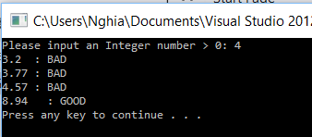
for statement Example
Write a program that
Allow user to input an Integer number N > 0
The program generates randomly N scores (from 0 to 10, real-valued)
The program prints out the scores and the corresponding rating as shown
Notes:
Đoạn code thứ 1: xuất ra một dãy số từ 0 đến 99
Đoạn code thứ 2: lặp vô hạn

Slide 18
for statement Example
#include <iostream>
#include <iomanip>
using namespace std;
int main(){
int N;
cout << ”Please input an Interger Number >0: ”;
cin >> N;
if(N <= 0)
cout << ”The program is not working with negative number\n”;
else{
//TODO: The code on the next slide is place here
}//end if
cout << "\n\n";
system("pause");
return 0;
}
Notes:
Đoạn code thứ 1: xuất ra một dãy số từ 0 đến 99
Đoạn code thứ 2: lặp vô hạn

Slide 19
for statement Example
time_t t;
srand((unsigned) time(&t));
for(int i=0; i<N; i++){
float diem = ((float) rand() / RAND_MAX)*10;
if(diem < 5.0f){
cout << left << setprecision(3) << diem << ": BAD" << endl;
}
else if(diem < 6.5f){
cout << left << setprecision(3) << diem << ": AVERAGE" << endl;
}
else if(diem < 8.5f){
cout << left << setprecision(3) << diem << ": FAIRLY GOOD" << endl;
}
else if(diem < 9.5f){
cout << left << setprecision(3) << diem << ": GOOD" << endl;
}
else{
cout << left << setprecision(3) << diem << ": EXCELLENT" << endl;
}
}//end for
Generate randomly N points
for loop statement
Rate & print
Notes:
Đoạn code thứ 1: xuất ra một dãy số từ 0 đến 99
Đoạn code thứ 2: lặp vô hạn

Slide 20
Nested for statement
Application
Used when dealing with multidimensional arrays
When we need to access the data in nested arrays Example: When we need to access student information, we can access by two step: - Browse all classes in the school (an array) - For each class, access the information of each student (another array inside the class element)
etc.

Slide 21
while statement Concept
false
<Condition>
true
<Statement>
<Condition>:
Can be a boolean expression or an expression that can be transformed to boolean type
<Statement>:
Can be single or composite statement
Notes:
Cụ thể: ở ví dụ trên
Kiểm tra trước = chưa tìm được người phù hợp
Làm sau = xem xét ứng viên tiếp theo

Slide 22
while statement Concept
Principles of execution
The program that checks the conditional expression
If condition is true
Execute statement
Jump to step checking stop condition
=> The loop must have an operation that changes the conditional expression so that the program does not loop infinitely
In contrast, (false) the program jump to the statement after the loop.
Notes:
Cụ thể: ở ví dụ trên
Kiểm tra trước = chưa tìm được người phù hợp
Làm sau = xem xét ứng viên tiếp theo

Slide 23
while statement Syntax
while(<Condition>)
<Statement>
The case implemented for complex statement
while(<Condition>){
<statement 1>
<statement 2>
<statement N>
}
Notes:
Cụ thể: ở ví dụ trên
Kiểm tra trước = chưa tìm được người phù hợp
Làm sau = xem xét ứng viên tiếp theo

Slide 24
while statement Syntax
Note with the while statement
The preceding statements (before while) often made the assignment so that the execution condition is satisfied
It is possible to assign control variables
It is possible to assign counter variables that count the index of the iterations
Etc.
There may be cases
while(true){ …}
while(1){…}
For these form, we need use break; statement
The meaning of break and continue statement is shown in section “for statement”
Notes:
Cụ thể: ở ví dụ trên
Kiểm tra trước = chưa tìm được người phù hợp
Làm sau = xem xét ứng viên tiếp theo

Slide 25
while statement Example
The program that calculates and prints the sum of squares of ten number from 1 to 10
#include <iostream>
using namespace std;
int main(){
int i =0;
int sum = 0;
while(++i <= 10){
sum += i*i;
}
cout << "Sum = " << sum <<endl;
system("pause");
return 0;
}
Pre-loop initialization is essential and important
Must change the condition expression inside the loop
Notes:
Cụ thể: ở ví dụ trên
Kiểm tra trước = chưa tìm được người phù hợp
Làm sau = xem xét ứng viên tiếp theo

Slide 26
do while statement Concept
Principles of execution
(1) The program immediately executes <Statement>
Therefore, <Statement> is executed at least 01 times
Once executed, the program evaluates the conditional expression and checks its value.
(2) If conditional expression is true
Jump to step (1) to execute <Statement>
(3) Otherwise, (false), the program jumps to the statement after the loop.
Notes:
Cụ thể: ở ví dụ trên
Kiểm tra trước = chưa tìm được người phù hợp
Làm sau = xem xét ứng viên tiếp theo

Slide 27
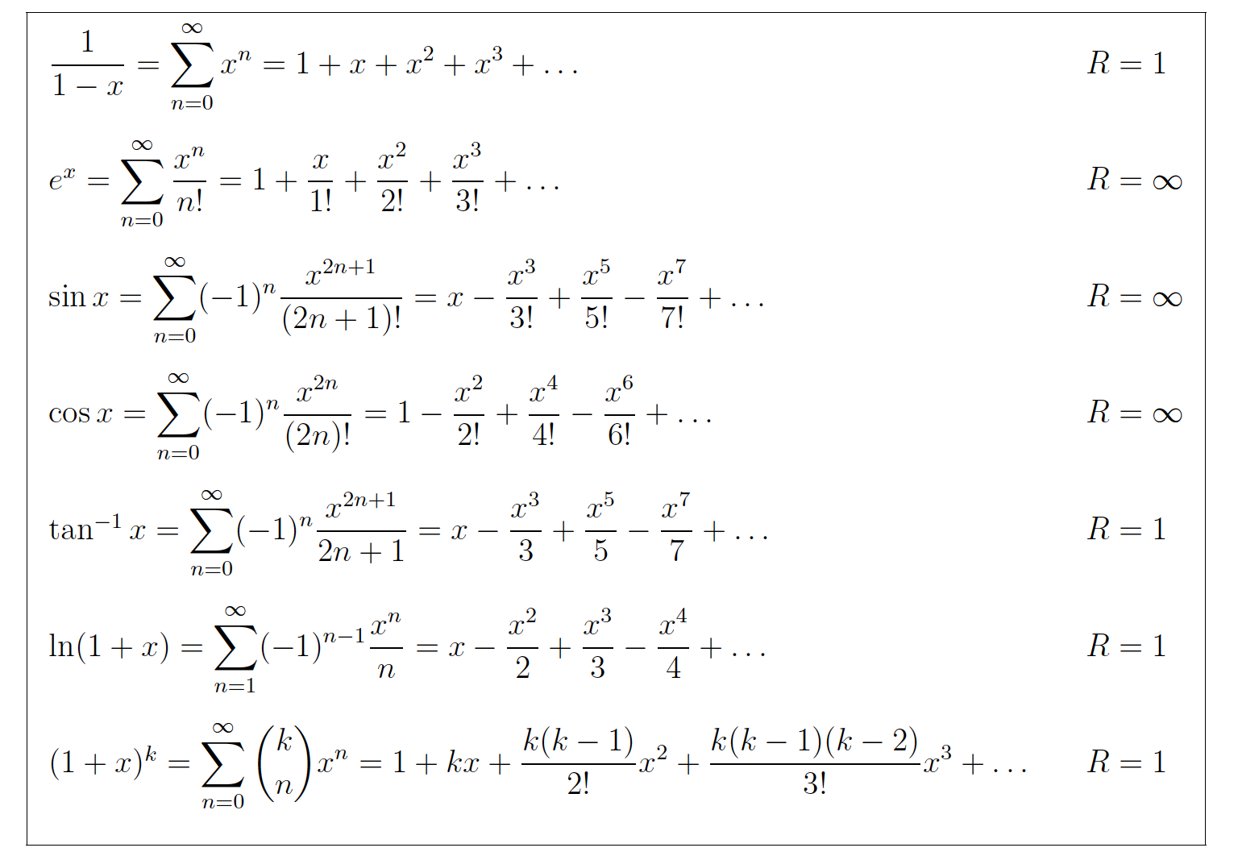
while statement Example
The program approximates the value of nonlinear functions
Dùng Taylor Maclaurin
Notes:
Cụ thể: ở ví dụ trên
Kiểm tra trước = chưa tìm được người phù hợp
Làm sau = xem xét ứng viên tiếp theo

Slide 28
do while statement Concept
<Statement>
true
<Condition>
false
<Condition>:
Can be a logical expression or an expression that can be transformed to logical
<Statement>:
Can be single or complex statement
Notes:
Cụ thể: ở ví dụ trên
Kiểm tra trước = chưa tìm được người phù hợp
Làm sau = xem xét ứng viên tiếp theo

Slide 29
do while statement Syntax
do{
<Statement>
} while <Condition>)
Implementation for composite statement:
do{
<statement 1>
<statement 2>
<statement N>
} while <Condition>)
Notes:
Cụ thể: ở ví dụ trên
Kiểm tra trước = chưa tìm được người phù hợp
Làm sau = xem xét ứng viên tiếp theo

Slide 30
do while statement Syntax
Note with the while statement
The preceding statements (before do) often made the assignments to determine the stop condition of the problem
The initial sum is zero
You can assign values to control variables
You can assign counter variable to count the number of loops
Etc.
The following cases can be used
do { …} while(true)
do { …} while(1)
For these forms, we need to use break; statement
The meanings of break and continue statement are the same as when “for statement” is used.
Notes:
Cụ thể: ở ví dụ trên
Kiểm tra trước = chưa tìm được người phù hợp
Làm sau = xem xét ứng viên tiếp theo

Slide 31
do while statement Syntax
Notes with the while statement
while and do-while are fairly similar except for one point:
while:
statement may not be executed
do While:
statement is executed at least 01 times
Assignment statements before (above) while and do While are very important to determine the stop condition of the loop
Notes:
Cụ thể: ở ví dụ trên
Kiểm tra trước = chưa tìm được người phù hợp
Làm sau = xem xét ứng viên tiếp theo

Slide 32
Some common mistakes when using loops
Infinite loop
Program failed to see or find the terminating condition
Program is able to find the termination condition, but the condition statement is not satisfied

Slide 33
Some common mistakes when using loops
Infinite loop
for (int i = 0; i < N; i++) { int j = 2; cout << i << ": "; while (j < i) { if (i % j == 0) { cout << j << " "; j++; } } cout <<endl; }

Slide 34
Exercise 1
Write a program to output the following string
Input: N ( Number of line)
Output: String is shown below * * * * * * * * * * * * * * *

Slide 35
Exercise 2
Write a program that output the following string
Input: N ( Number of line)
Output: String is as shown below * * ** ** *** *** **** **** *********

Slide 36
Exercise 3
Write the program that output to console likes bellow
Input: N (Number of lines of the square matrix )
Output: The matrix contains numbers in spiral form
With N = 4, we have a matrix
1 2 3 4 12 13 14 5 11 16 15 6 10 9 8 7

Slide 37
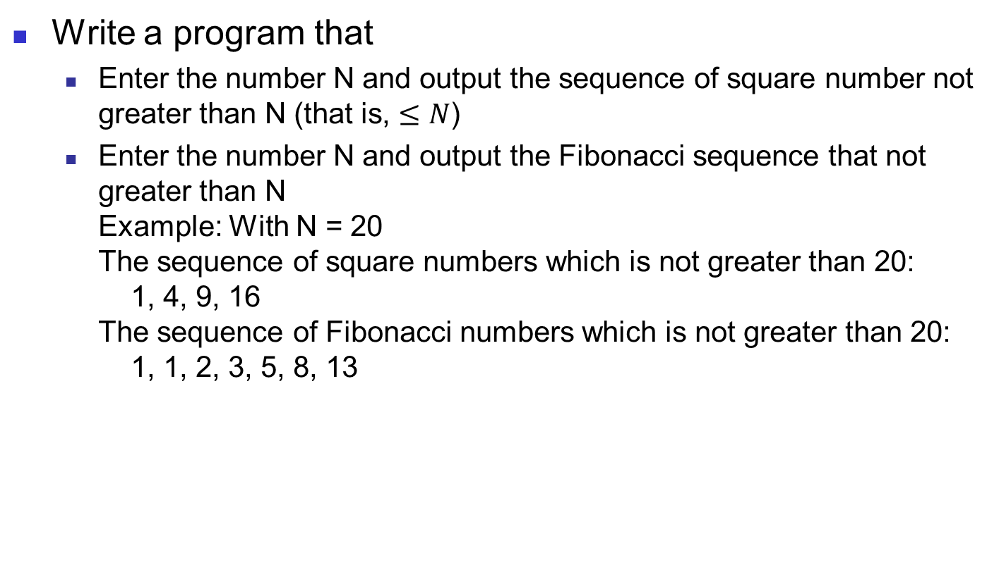
Exercise 4
Write a program that
Enter the number N and output the sequence of square number not greater than N (that is, $≤N$)
Enter the number N and output the Fibonacci sequence that not greater than N Example: With N = 20 The sequence of square numbers which is not greater than 20: 1, 4, 9, 16 The sequence of Fibonacci numbers which is not greater than 20: 1, 1, 2, 3, 5, 8, 13
Notes:
Hãy sửa lại file Ex4_Error để chương trình chạy đúng

Slide 38
Summary
You should understand the execution principles of loop statements
Know how to use the loop statements to solve the practical problem
Notes:
Hãy sửa lại file Ex4_Error để chương trình chạy đúng

